Slide 1
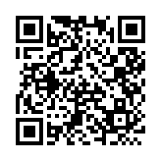
A Beta-Neutral Crypto ML Strategy: From Signal Inversion to Robust Alpha
Student Name: Sam, Bill, Jannis
Advisor Name: Hui Wen Teng
2025 Machine Learning & Fintech

Slide 2
Motivation
Data Preprocessing
Factor Engineering & EDA
Cross-Sectional ML Prediction
Portfolio Construction
Results & Interpretation
Machine Learning & FinTech 2025

Slide 3
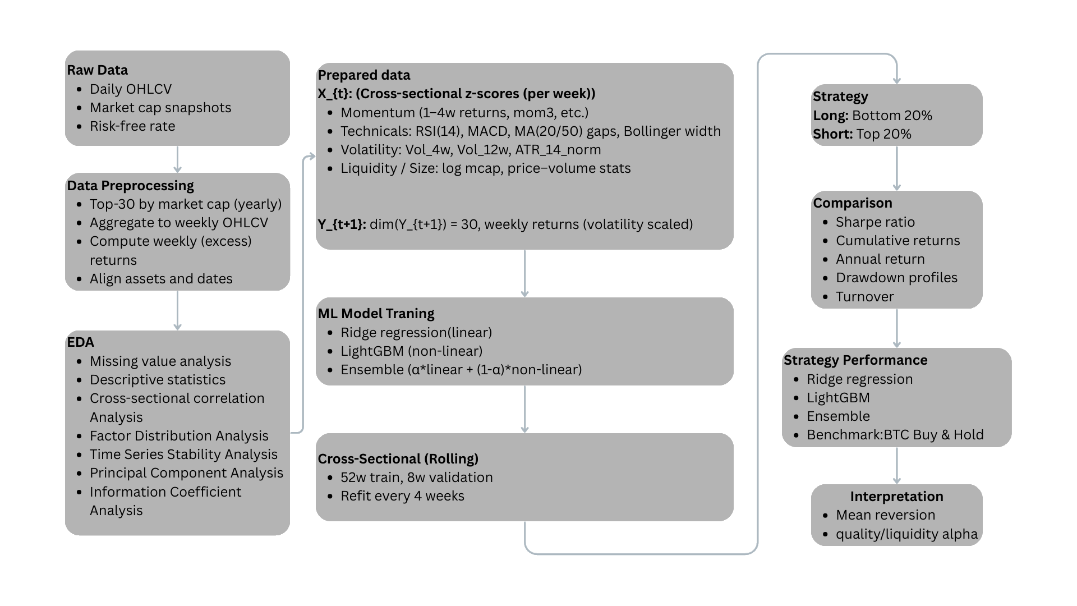
Machine Learning & FinTech 2025

Slide 4
Motivation
Motivation
Market Problem
Crypto markets exhibit extreme volatility; single assets like BTC frequently suffer -50% to -70% drawdowns.
Traditional long-only BTC or index exposure delivers high returns in bull markets but catastrophic losses in bear markets.
Institutional and professional investors need stable, risk-controlled strategies with superior risk-adjusted returns to BTC.
Machine Learning & FinTech 2025

Slide 5
Motivation
Motivation
Research Objectives
Build a beta-neutral, long–short, cross-sectional ML strategy that captures relative performance (alpha) while minimizing market-direction exposure (beta).
Control risk: reduce annual volatility and max drawdown to institutionally acceptable levels.
Improve Sharpe: target a long-run Sharpe ratio above 2.
Explain alpha sources: use feature importance and Rank IC to identify which factors drive excess returns (mean reversion, quality, liquidity, etc.).
Machine Learning & FinTech 2025

Slide 6
Section Title
Data Preprocessing
Data Sources & Universe
Weekly OHLCV prices and base factors (Binance Spot Market)
Market factor: crypto market index CMKT (Binance Spot Market)
Annual universe: selecting the top 30 large-cap / liquid assets per year.
4-week Treasury Bill rate (DTB4WK)
Build dataset with weekly frequency
Keep only the intersection of annual top 30 and complete weekly data to ensure tradability and data quality.
Machine Learning & FinTech 2025

Slide 7
Section Title
Data Preprocessing
Exploratory Data Analysis
Missing value analysis
Descriptive statistics
Cross-sectional correlation Analysis
Factor Distribution Analysis
Time Series Stability Analysis
Principal Component Analysis
Information Coefficient Analysis
Machine Learning & FinTech 2025

Slide 8
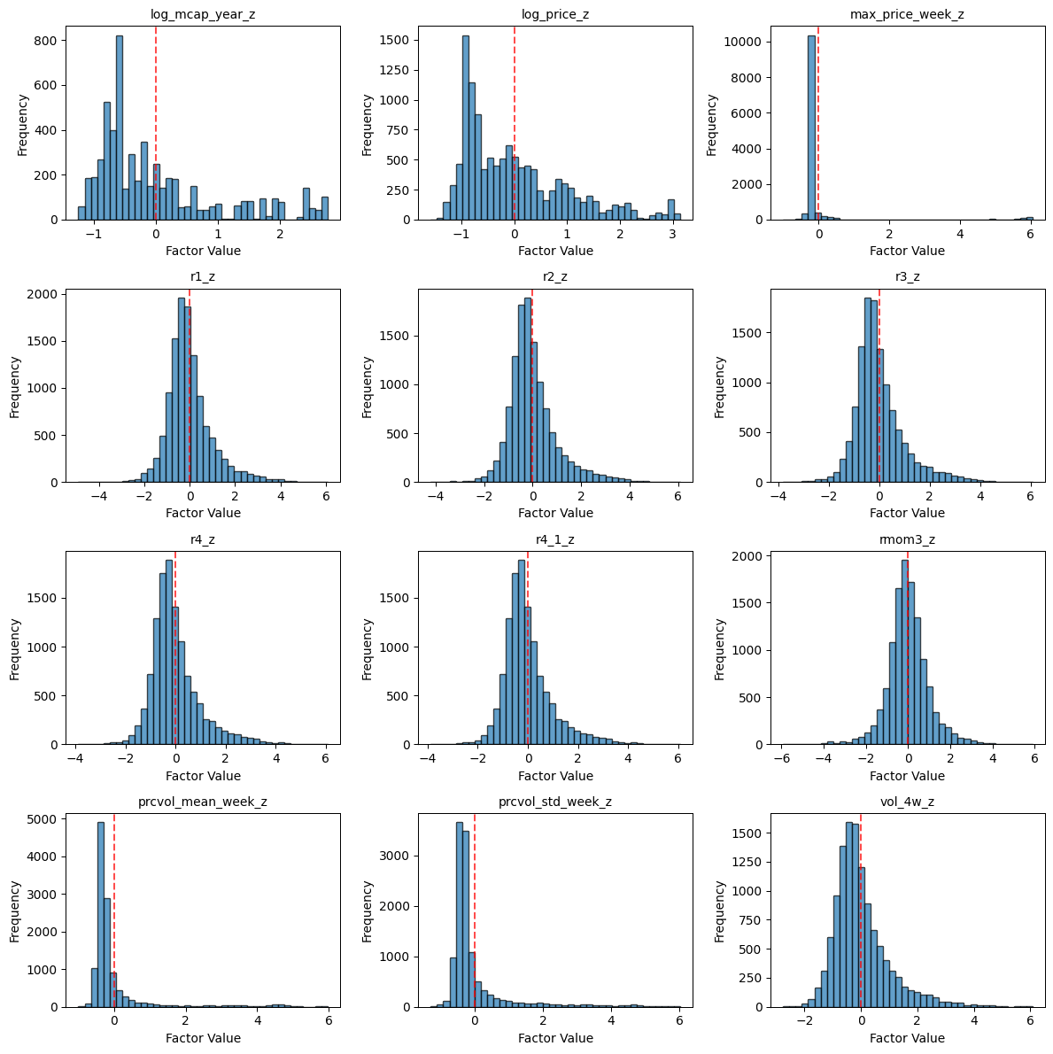
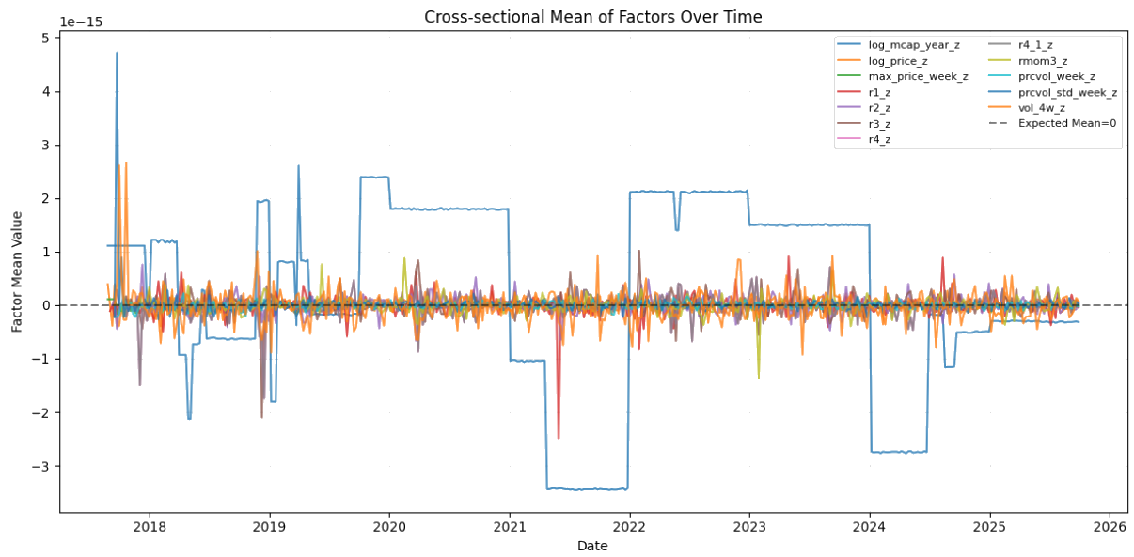
Section Title
Data Analysis
Machine Learning & FinTech 2025

Slide 9
Section Title
Feature Engineering & EDA
Technical & Risk Features
We extract from weekly OHLCV :
RSI (14): overbought / oversold conditions.
ATR (14) / Price: relative volatility.
Bollinger Band Width (20): range-based volatility.
MACD Histogram: trend momentum shifts.
Price / MA(20, 50): deviation from moving averages.
Rolling Volatility (4w, 12w): short- and medium-term risk.
All features are cross-sectionally z-scored per week, focusing on relative levels within each week and enabling cross-sectional ranking.
Machine Learning & FinTech 2025

Slide 10
Section Title
Feature Engineering & EDA
Feature Importance
Top-20 LightGBM Gain features are dominated by:
Short-/medium-term returns: r1_z, r2_z, r3_z, r4_z, mom3_z.
Technical indicators: Close_div_MA20_z, RSI_14_z, Close_div_MA50_z, MACD_z.
Volatility & ranges: Vol_12w_z, Vol_4w_z, ATR_14_norm_z, BB_Width_20_z.
Liquidity/volume: prcvol_mean_week_z, prcvol_std_week_z.
Conclusion: the model heavily relies on “short-term momentum + technical + volatility/volume” signals, while size/price play a supporting backbone role.
Machine Learning & FinTech 2025

Slide 11
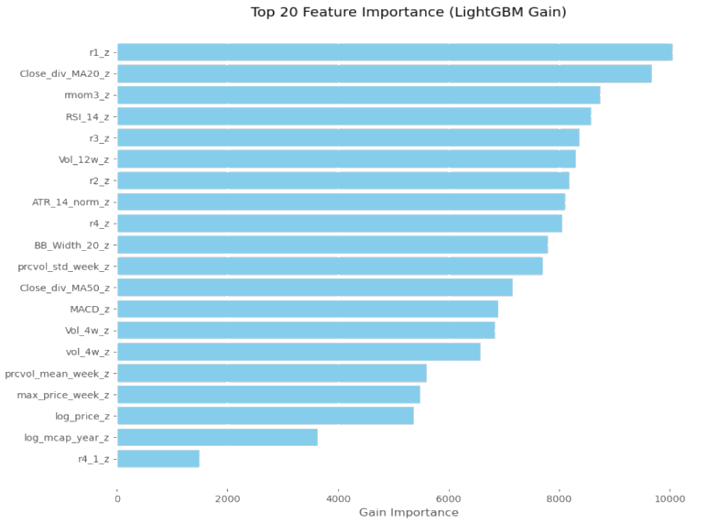
Section Title
Feature Engineering & EDA
Feature Importance
Machine Learning & FinTech 2025

Slide 12
Section Title
Feature Engineering & EDA
Rank IC Evidence
Factors with positive Mean Rank IC:
log_mcap_year_z, log_price_z, max_price_week_z, prcvol_mean_week_z, prcvol_std_week_z.
⇒ Large-cap, higher-priced and more liquid/active assets tend to have better risk-adjusted returns (quality / liquidity tilt).
Factors with negative Mean Rank IC:
Vol_4w_z, Vol_12w_z, ATR_14_norm_z, BB_Width_20_z.
⇒ High-volatility, high-ATR assets typically underperform, making them good short or de-weighting candidates.
Cumulative Rank IC shows that size/liquidity factors accumulate IC over time, indicating persistent structural alpha rather than one-off episodes
Machine Learning & FinTech 2025

Slide 13
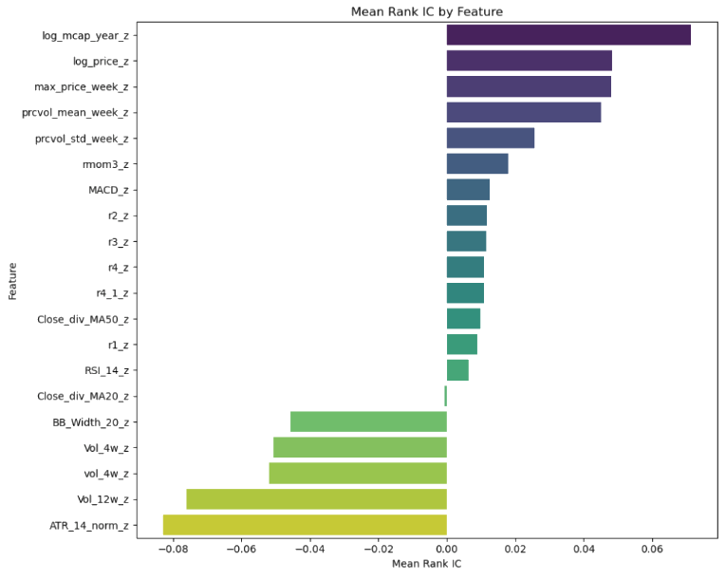
Section Title
Feature Engineering & EDA
Rank IC Evidence
Machine Learning & FinTech 2025

Slide 14
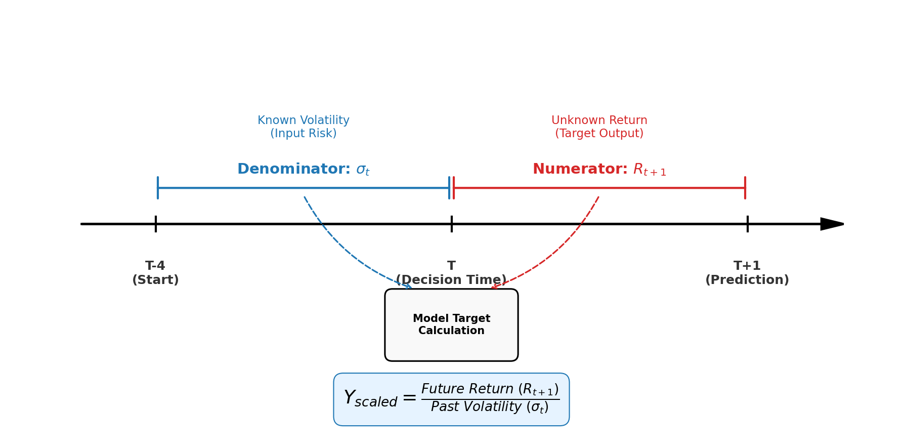
Section Title
Cross-Sectional ML Prediction
Machine Learning & FinTech 2025

Slide 15
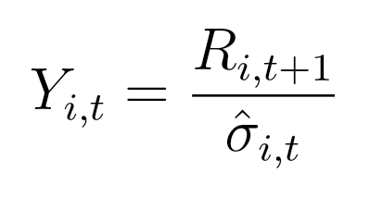
Section Title
Cross-Sectional ML Prediction
Volatility-Scaled Target
Prediction target:
Ref: Moreira, A., & Muir, T. (2017). Volatility-Managed Portfolios. The Journal of Finance.
Machine Learning & FinTech 2025

Slide 16
Section Title
Cross-Sectional ML Prediction
DART Boosting / Model Architecture & DART
Main model: LightGBM LambdaRank (cross-sectional ranking)
DART = Dropouts meet Additive Regression Trees.
Randomly drops part of the existing trees before fitting a new one
Benefits: reduces overfitting and improves generalization, especially on noisy financial data.
Auxiliary model: Ridge Regression
Provides a linear, smooth baseline and mitigates extreme nonlinear biases.
Ensemble: 0.6 LGB + 0.4 Ridge
Ref: Gu, S., Kelly, B., & Xiu, D. (2020). Empirical Asset Pricing via Machine Learning. The Review of Financial Studies.
Machine Learning & FinTech 2025

Slide 17
Section Title
Cross-Sectional ML Prediction
Rolling Walk-Forward Setup
Use at least 52 weeks of history as the initial training set; the most recent 8 weeks are used for validation.
Refit the model every 4 weeks, processing a total of 373 weeks of data.
Each week is treated as a ranking group; the model learns which assets should rank higher or lower within the same week.
Ref: López de Prado, M. (2018). Advances in Financial Machine Learning.
Machine Learning & FinTech 2025

Slide 18
Section Title
Portfolio Construction
Bucketing & Signal Inversion
Each week, ensemble scores are bucketed into 5 quantiles (Q=5).
raw scores are negatively correlated with future returns.
Long: bottom 20% (lowest-score quantile).
Short: top 20% (highest-score quantile).
Interpretation: the model effectively detects over-extended assets; high scores indicate short-term overheating and likely mean reversion, while low scores correspond to overlooked but higher-quality names.
Machine Learning & FinTech 2025

Slide 19
Section Title
Portfolio Construction
Risk Constraints
Total gross leverage: GROSS_LEV = 1.0 (|long| + |short| = 100%).
Per-asset weight cap: |w_i| ≤ 10%.
Weekly per-asset turnover cap: |Δw_i| ≤ 30%.
One-way transaction cost: 10 bps.
Goal: control concentration and trading frictions, making the strategy implementable in practice.
Machine Learning & FinTech 2025

Slide 20
Section Title
Portfolio Construction
Beta Neutrality & Vol Targeting
Estimate each asset’s beta via a 52-week rolling regression on CMKT.
Adjust portfolio weights by
to achieve near beta neutrality.
Using 26-week historical volatility, scale exposure to keep annualized volatility around 30%:
De-leverage in high-vol regimes, scale up in low-vol regimes.
Result: a stable and more investable risk profile.
Machine Learning & FinTech 2025

Slide 21
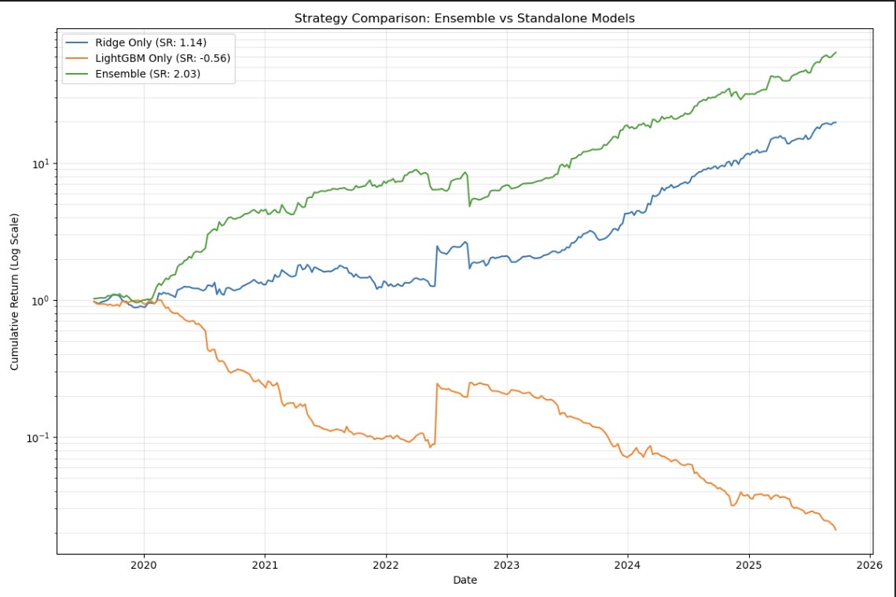
Section Title
Results & Interpretation
Strategy Comparison: Ensemble vs Standalone Models
The ensemble (green) compounds much more smoothly than either standalone model, achieving the highest cumulative growth.
LightGBM alone suffers severe drawdowns, while Ridge is stable but weaker–highlighting the benefit of combining both.
Machine Learning & FinTech 2025

Slide 22
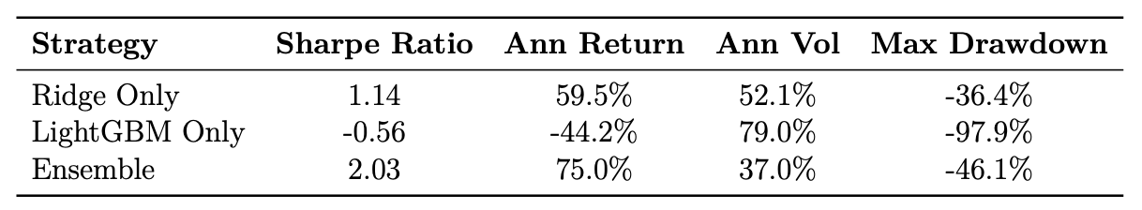
Section Title
Results & Interpretation
Performance Summary of Strategies
The ensemble delivers the highest Sharpe ratio strongest annual return, with substantially lower volatility than LightGBM alone.
Ridge performs moderately well, white LightGBM’s instability leads to both negative returns and extreme drawdowns.
Machine Learning & FinTech 2025

Slide 23
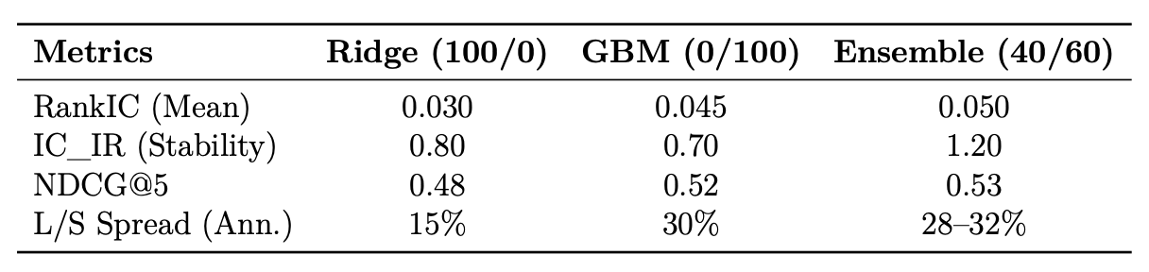
Section Title
Results & Interpretation
Predictive Metrics Across Models
The ensemble achieves the best RankIC, strongest IC stability, and the highest long–short spread.
Combining linear and nonlinear rankers enhances both predictive accuracy and tradability.
Machine Learning & FinTech 2025

Slide 24
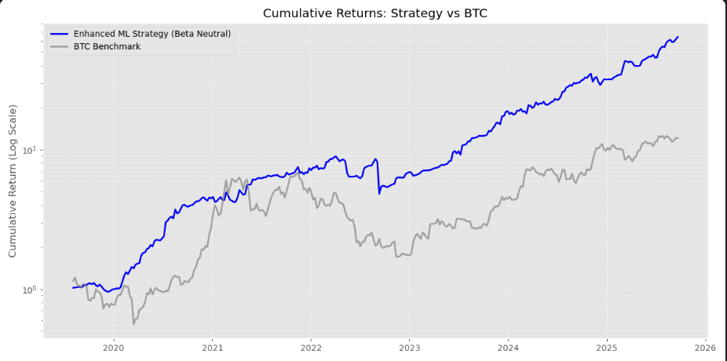
Section Title
Results & Interpretation
Cumulative returns (log scale)
The beta-neutral strategy (blue) shows a smooth, steadily rising curve, clearly outperforming BTC (gray) over the full sample.
Log scale allows fair comparison across different compounding phases.
Machine Learning & FinTech 2025

Slide 25
Section Title
Results & Interpretation
ML Strategy VS BTC Benchmark
 | Benchmark | Strategy
Annual Return | 38% | 75%
Annual Volatility | 95% | 37%
Sharpe Ratio | 0.4 | 2.03
Max Drawdown | -70.1% | -46.1%
Avg Turnover | 0.72 | 0.72
Machine Learning & FinTech 2025

Slide 26
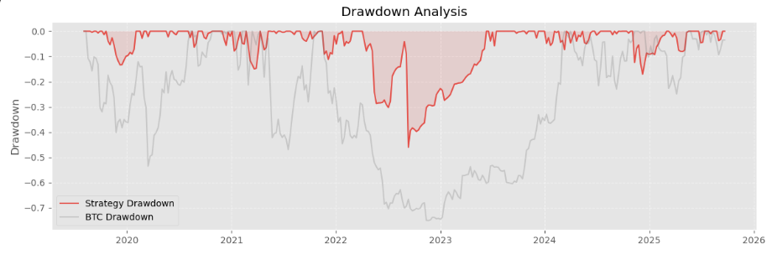
Section Title
Results & Interpretation
Drawdown
Strategy max drawdown is around -20% to -25%, with most periods within -10%.
BTC experiences multiple drawdowns beyond -50%, approaching -70%.
Machine Learning & FinTech 2025

Slide 27
Section Title
Results & Interpretation
Feature Importance & Signal Inversion
LightGBM primarily relies on momentum + technical + volatility features:
High-scoring assets are typically “recent high flyers with elevated volatility and overheated technicals.”
Mean Rank IC shows volatility and ATR-type features carry negative signals:
The more volatile the asset, the worse it tends to perform next week.
⇒ Over-extended assets likely to underperform,
Inverting the signal (long low scores, short high scores) with a mean-reversion strategy.
Machine Learning & FinTech 2025

Slide 28
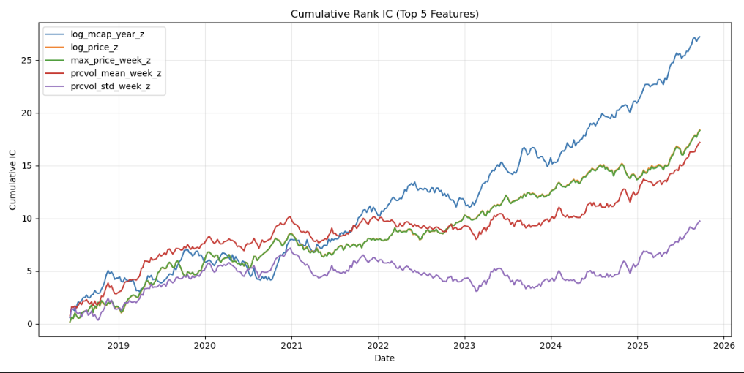
Section Title
Results & Interpretation
Cumulative Rank IC
Machine Learning & FinTech 2025

Slide 29
Section Title
Results & Interpretation
Cumulative Rank IC
Large-cap, liquid, high-attention assets consistently outperform on a risk-adjusted basis, creating a structural quality/liquidity alpha.
The strategy effectively combines two core components:
A quality/liquidity tilt toward large, liquid names.
A mean-reversion short/underweight leg against short-term over-extended, high-volatility names.
Machine Learning & FinTech 2025

Slide 30
Section Title
Results & Interpretation
Conclusion
Starting from the motivation: in a noisy, highly volatile crypto market, we aim for a risk-controlled, beta-neutral alpha strategy.
Through data filtering and feature engineering, we focus on the annual top-30 large-cap universe and build momentum, technical, volatility, liquidity, and size factors.
Using a volatility-scaled target with DART-LightGBM and Ridge ensemble, we learn which assets will outperform on a risk-adjusted basis in the next week.
Empirically, model scores detect “over-extended vs stable high-quality” assets, which naturally leads to signal inversion plus long–short, beta neutrality, and volatility targeting.
Final outcome:
Cumulative returns consistently outperform BTC;
Annual volatility and max drawdown are greatly reduced;
Sharpe ≈ 2 with a clear, interpretable strategy (mean reversion + quality/liquidity).
Machine Learning & FinTech 2025

Slide 31
A Beta-Neutral Crypto ML Strategy: From Signal Inversion to Robust Alpha
Student Name: Sam, Bill, Jannis
Advisor Name: Hui Wen Teng
2025 Machine Learning & Fintech

